Slide 1
Introduction to MongoDB and Java Driver
Steve Briskin
Software Engineer, 10gen

Slide 2
What is MongoDB
General-Purpose, Document (Object) Database
Flexible Schema
Secondary Indexes
Rich Query Support
Replication – High Availability
Sharding – Horizontal Scaling
Notes:
Free, Open Source
Written for developers

Slide 3























































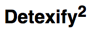

























































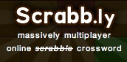












Who Uses MongoDB
Notes:
Ebay, disney, foursquare, shutterfly, craigslist
international investment banks, Telecoms, Healthcare, Government agencies

Slide 4
Terminology
RDBMS |  | MongoDB
Table, View | ➜ | Collection
Row | ➜ | Document
Index | ➜ | Index
Join | ➜ | Embedded Document
Foreign Key | ➜ | Reference
Partition | ➜ | Shard

Slide 5
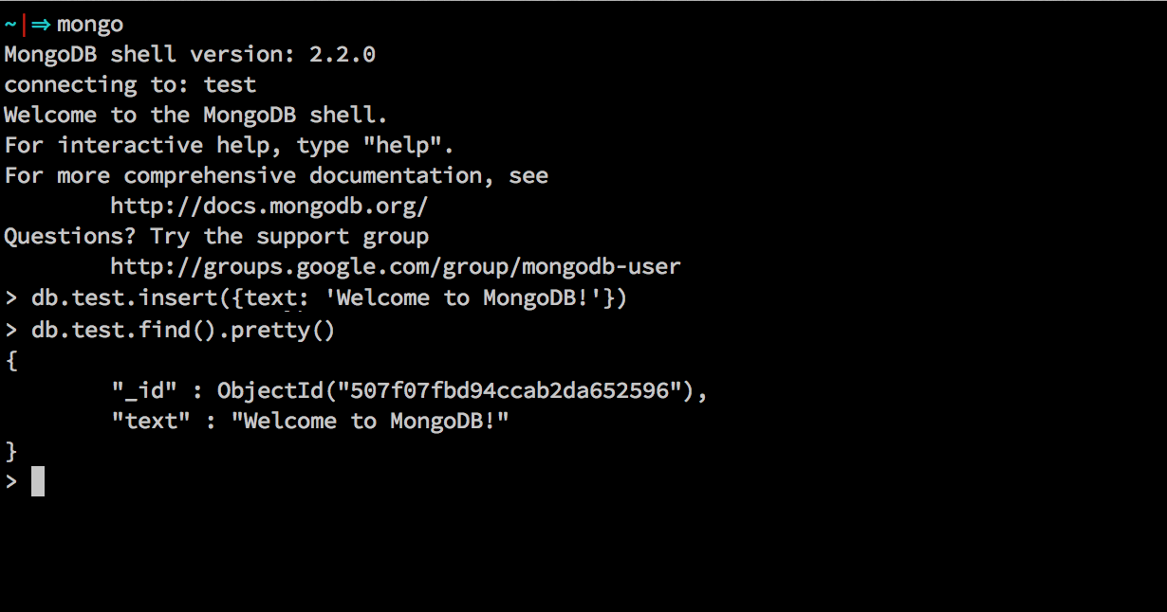
Mongo Shell

Slide 6
Flexible Schema
No pre-defined schema
Normalization and Joins not required
Embedded documents and arrays
Stored as BSON documents
{ a : 5 } { a : 1, b : 2 } { a : 1, b : { c : 2 } } { z : [ 1, “abc”, 2.5 ] }
Notes:
Store data the way you use it!
No DBs, collections, imbedded objects, arrays, maps, optional fields, and all standard types
No pre-defined schema per collection
Result: quick iteration, no data migrations

Slide 7
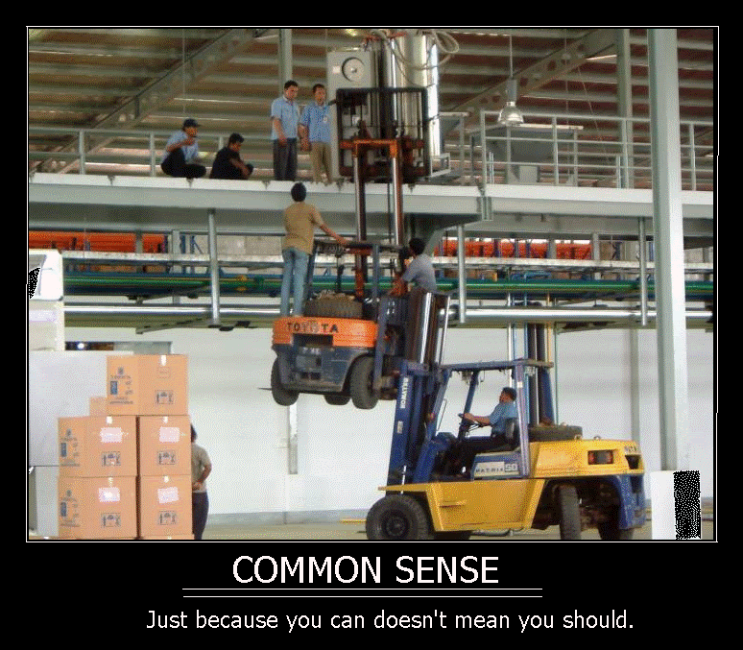
Flexible Schema
Notes:
Don’t shoot yourself in the foot!
Normalization is a tool, use it where appropriate

Slide 8
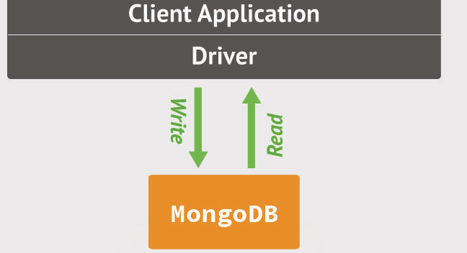
Java Driver
Notes:
Java driver – communication with Mongo, exposes API in a Java-friendly way

Slide 9
Building an App – Order Reporting
Functional Requirements
Order – ID, quantity, account, product, executions
Persist order details, including updates
Persist executions
Query by account, product, execution
Application Considerations
Schema
CRUD
Redundancy
Scalability
Notes:
Financial. My last project.

Slide 10
Classes
Order
Id
Account
Quantity
Order
Id
Account
Quantity
Product
Executions
Product
Symbol
SymbolType
Product
Symbol
SymbolType
Execution
Id
Quantity
Price
Execution
Quantity
Price
Notes:
I make the decision to denormalize
Keep this slide up

Slide 11
Classes
class Order { String id; String account; int quantity; Product product; List<Execution> executions; } | class Execution { String id; int qty; double price; } class Product { String symbol; int symbolType; }
Notes:
Keep this slide up

Slide 12
POJO to DBObject
Execution: public DBObject toDBObject() { DBObject toRet = new BasicDBObject(); toRet.put("id", id); toRet.put("quantity", quantity); toRet.put("price", price); return toRet; }
Product: public DBObject toDBObject() { DBObject toRet = new BasicDBObject(); toRet.put("symbol", symbol); toRet.put("type", symbolType); return toRet; }

Slide 13
POJO to DBObject
Order: public DBObject toDBObject() { DBObject toRet = new BasicDBObject(); toRet.put("_id", id); toRet.put("account", account); toRet.put("quantity", quantity); toRet.put("product", product.toDBObject()); List<DBObject> execs = new ArrayList<DBObject>(); for (Execution exec : executions) execs.add(exec.toDBObject()); toRet.put("executions", execs); return toRet; }

Slide 14
Connect
MongoClient()
MongoClient(String host, int port)
MongoClient(MongoClientURI uri)
MongoClient(ServerAddress addr)
MongoClient(List<ServerAddress> seeds)
…more
MongoClient mongo; public void connect() { mongo = new MongoClient(); //localhost:27017 //mongo = new MongoClient(”localhost", 27017); //mongo = new MongoClient( new MongoClientURI("mongodb://localhost:27017")); }
Notes:
MongoClientURI – let’s you seed replica set memebers, pass options

Slide 15
Insert and Upsert
insert(DBObject... arr)
save(DBObject jo)
public void persistOrder(Order order) { DB db = mongo.getDB("reporter") DBCollection ordersCollection = db.getCollection("orders"); DBObject toInsert = order.toDBObject(); ordersCollection.insert(toInsert); //ordersCollection.save(toInsert); //upsert }
Notes:
DB and Collection are created on the fly

Slide 16
Update and Upsert
update(DBObject query, DBObject update)
public void addExecutionUpdate(Order order, Execution exec) { DBObject execDBObj = exec.toDBObject(); DBObject query = new BasicDBObject("_id", order.getId()); DBObject update = new BasicDBObject("$push", new BasicDBObject("executions", execDBObj)); ordersCollection.update(query, update); }
public void addExecutionUpsert(Order order, Execution exec) { order.getExecutions().add(exec); DBObject orderDBObj = order.toDBObject(); ordersCollection.save(orderDBObj); }

Slide 17
Query
find(DBObject query)
findOne(DBObject o)
…more
public void findOrderByAccount(String account) { DBObject query = new BasicDBObject(“account”, account); DBCursor cursor = ordersCollection.find(query); while (cursor.hasNext()) { DBObject order = cursor.next(); //do stuff } }
public void findOrderByExecutionId(String execId) { DBObject query = new BasicDBObject("executions.id", execId); DBObject order = ordersCollection.findOne(query); //do stuff }

Slide 18
Indexing
Secondary Indexes
ensureIndex() command
Compound indexes
TTL, Geo, Text
db.orders.ensureIndex( {“account “ : 1} ) db.orders.ensureIndex( {“account” : 1, “product” : 1} ) db.orders.ensureIndex( {“executions.id” : 1} )
Notes:
EnsureIndex takes index fields, sort direction, and options
Index on simple type, compound type, array

Slide 19
Remove
remove(DBObject jo)
public void deleteOrder(Order order) { DBObject toDelete = new BasicDBObject(“_id”, order.getId()); ordersCollection.remove(toDelete); }

Slide 20
Replication

Slide 21
Replication
Redundancy for High Availability
Single Primary
Notes:
Each node on a different machine in a different DC

Slide 22
Replica Set – Failover
Notes:
New primary elected. Replication established from new primary
Java driver automatically fails over. No application involvement required!
Hurricane takes out NYC, Chicago will still be up

Slide 23
Read Preference
Ability to read from Secondaries
Primary (default) – Strong Consistency
Secondary, SecondaryPreferred, PrimaryPreferred

Slide 24
Read Preference
//per connection mongo.setReadPreference(ReadPreference.secondaryPreferred()); //per database DB db = mongo.getDB(“reporter”); db.setReadPreference(ReadPreference.secondaryPreferred()); //per collection DBCollection coll = db.getCollection(“orders”); coll.setReadPreference(ReadPreference.secondaryPreferred()); //per operation coll.find(new BasicDBObject(), ReadPreference.secondaryPreferred());

Slide 25
Write Concern
WriteConcern |  | Success Condition
Errors Ignored | ➜ | Always
Unacknowledged | ➜ | Written to Socket
Acknowledged | ➜ | In Memory
Journaled | ➜ | Disk – Journal
Fsynced | ➜ | Disk – Data Files
Replica Acknowledged | ➜ | Acknowledged by at Least 2 Members
Notes:
Performance and durability are inversely proportional.
Acknowledged is the default. Adjust as needed.

Slide 26
Write Concern
//per connection mongo.setWriteConcern(WriteConcern.ACKNOWLEDGED); //per database DB db = mongo.getDB(“reporter”); db.setWriteConcern(WriteConcern.ACKNOWLEDGED); //per collection DBCollection coll = db.getCollection(“orders”); coll.setWriteConcern(WriteConcern.ACKNOWLEDGED); //per operation coll.insert(new BasicDBObject(), WriteConcern.ACKNOWLEDGED);
Notes:
No need to start with DB schema design, start with application!

Slide 27
Sharding

Slide 28
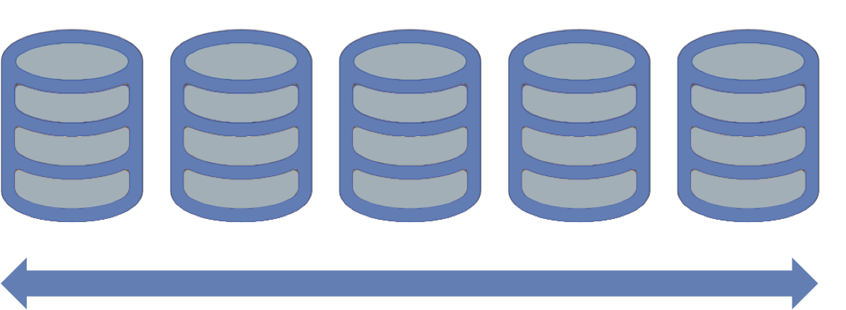
Sharding
Horizontal Scaling
Requires No Application Changes
User-Defined Shard Key
Notes:
Project a success – now scale
Shard by account or product

Slide 29
What is a Shard?
Shard is a node of the cluster
Shard can be a single mongod or a replica set

Slide 30
Meta Data Storage
Config Server
Stores cluster chunk ranges and locations
Can have only 1 or 3 (production must have 3)
Not a replica set

Slide 31
Routing and Managing Data
Mongos
Acts as a router / balancer
No local data (persists to config database)
Can have 1 or many

Slide 32
Sharding Infrastructure

Slide 33
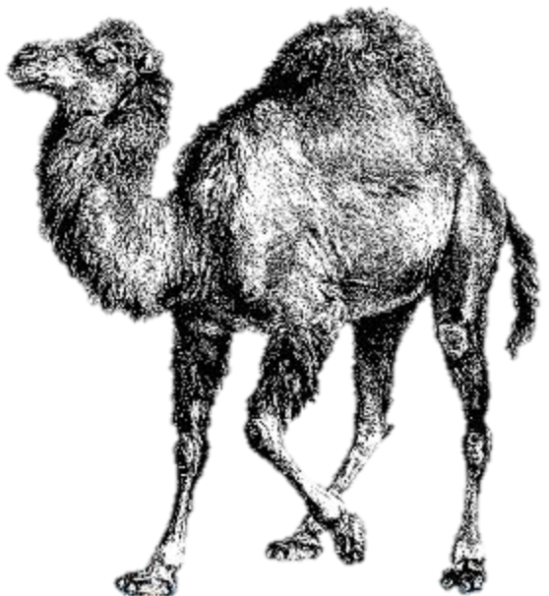

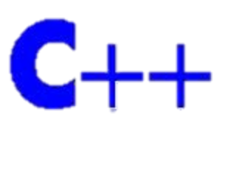









Tools
Java
New Java Driver coming soon
Morphia – ODM
Spring Data
12 Native Drivers, 30+ Community
Notes:
Java driver can be prettier – new driver coming up with serializers
Spring Data - Mark Pollock

Slide 34
Community & Resources
Download MongoDB – mongodb.org
Community/Events/Webinars – 10gen.com/events
Free Online Education – education.10gen.com
Newsletter -- 10gen.com/signup
Register for MongoDB NYC – June 21st
http://bit.ly/mongodbNYC
Notes:
Easy to learn
30,000 people signed up for classes

Slide 35
Thank You
Steve Briskin
Software Engineer, 10gen

